Slide 1
GBTA APAC Conference 2023 - Singapore Photo Feed Sponsorship

Slide 2
GBTA is excited to announce a new and one-of-a-kind sponsorship opportunity for GBTA APAC Conference 2023 - Singapore Photo Feed.
Using state-of-the-art photo technology (powered by our partner, GetPica), attendees will be delighted to see all the pictures that they appear in GBTA APAC Conference 2023 - Singapore. And you, as sponsor, will have the exclusive ability to brand this highly engaging photo stream.

Slide 3
How it Works
GBTA has partnered with GetPica as its technology partner for this sponsorship.
GetPica technology will power the Photo Feed.
All the photos which they appear in - and only the ones they are in – appear in the GBTA Conference Photo Feed.
Guests can download, share, print these photos, and they will always be available anytime they want to go back and see them, they simply look in the event album.
GBTA will promote the GetPica experience to registered attendees before, during, and after the event to drive maximum adoption.
Attendees will visit GetPica in their browser or download the GetPica app and take a selfie to get started.
You as sponsor will have the ability to insert video or static content into the stream, which will appear at the beginning. In addition, the photo stream will be branded with your logo.
GBTA will have professional photographers on-site at in Hamburg who will take thousands of pictures of the attendees.
GBTA APAC Conference 2023 - Singapore | Photo Feed Sponsorship

Slide 4
Sponsor Benefits
Delivery of strategic content
Your video ad will appear at the top of the Photo Feed.
You’ll have the ability to Insert a 30 second advertisement or message to
promote your brand presence GBTA APAC Conference 2023 - Singapore.
Brand recognition
GBTA will promote the GetPica experience along with your logo and sponsorship in the pre-event communication to attendees.
Your logo will be included in the Sponsor section of GBTA APAC Conference 2023 - Singapore website.
Your logo will appear inside the GetPica app alongside the photo feed.
Your logo will be featured at the event registration desk and recognized on the main stage.
The photo feed will remain live for 12 months after the event –
providing post-event branding.
Registration Passes
2 Passes to GBTA APAC Conference 2023 - Singapore are included with this sponsor package
Analytics
Within 2 weeks after conclusion of GBTA APAC Conference 2023 - Singapore, you will receive a report of app engagement including number of downloads and number of views
Price
$10,000 USD
GBTA APAC Conference 2023 - Singapore | Photo Feed Sponsorship

Slide 5
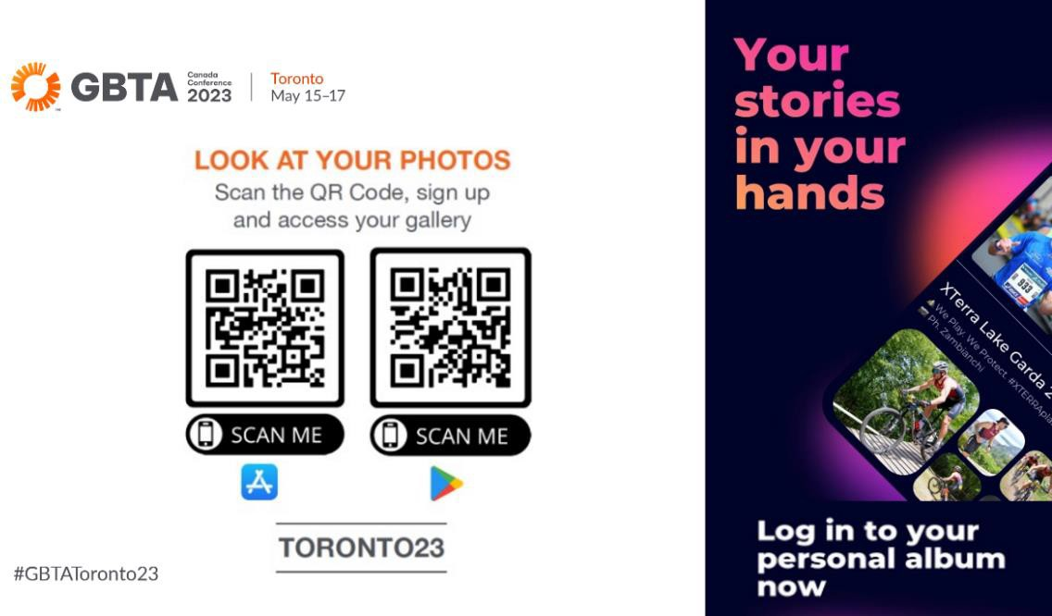
Sample Graphics from the GBTA Canada Conference 2023 - Toronto
This is a sample QR Code and Promotion of the App to Drive Downloads:

Slide 6
Sample Photo with Sponsor Logo / Branding

Slide 7
If interested, please contact us at sponsor@gbta.org.
About GBTA:
The Global Business Travel Association (GBTA) is the world’s premier business travel and meetings trade organization headquartered in the Washington, D.C. area serving stakeholders across six continents. GBTA and its 7,600+ members represent and advocate for the $1.158 trillion global business travel and meetings industry. GBTA and the GBTA Foundation deliver world-class education, events, research, advocacy, and media to a growing global network of more than 28,000 travel professionals and 125,000 active contacts.
For more information, visit gbta.org and
gbtafoundation.org.

